Slide 1





Webster Bank
Your 2024 Delta Dental Plans

Slide 2

Delta Dental Program Change
Effective January 1, 2024, we are transitioning to Delta Dental
NEW dental benefits are being added for January 1st !
More In-Network Providers!

Slide 3

Getting the most from your Delta Dental benefits
Available networks
Your dental plan options
Special Health Care Needs benefit enhancement
ID cards
Member experience
Contact Delta Dental

Slide 4
Delta Dental PPO Plus Premier™ nationwide networks
If you use a Delta Dental PPO™ dentist
Your out-of-pocket costs will be lowest for services if you use a participating PPO dentist
Your annual maximum stretches further because the PPO dentists' fees are lower
Participating dentists may not charge more than Delta Dental’s allowed charges, and are paid directly by Delta Dental for covered services
If you use a Delta Dental Premier® dentist
Our largest nationwide network
Your out-of-pocket costs will be higher, and your plan maximum will not go as far, since Premier dentists' fees are not as discounted as PPO dentists
Participating dentists may not charge more than Delta Dental’s allowed charges, and are paid directly by Delta Dental for covered services
You may use dentists that do not participate with Delta Dental
You are responsible for submitting the claim
You are responsible for making payment to the dentist
Your out-of-pocket costs are highest when you use non-participating dentists
Delta Dental PPOTM
Premier®

Slide 5
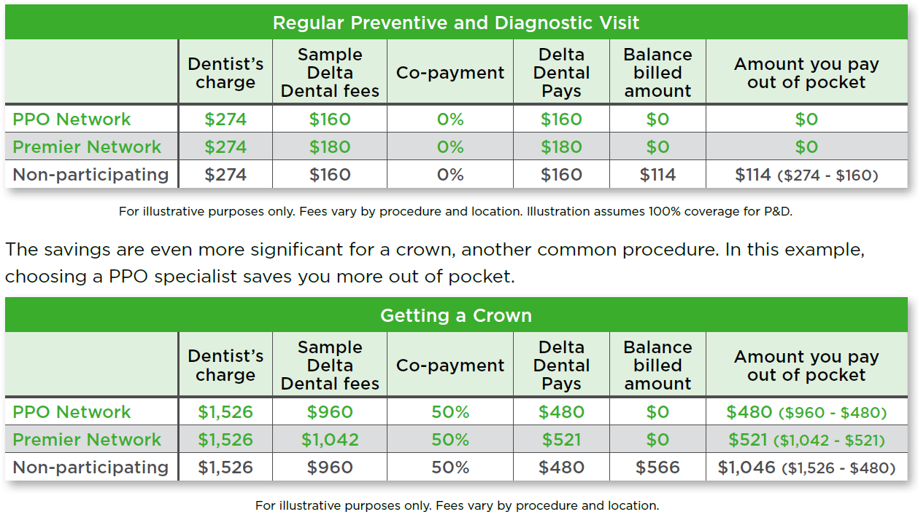
Your Delta Dental PPO Plus Premier™ Plan At a Glance
* Please note that an out-of-network provider is not bound by Delta Dental’s in-network contractual obligations and may bill patients for the remaining balance, called balance billing. The practice of balance billing refers to a provider’s ability to bill patients for outstanding balances after the insurance company pays the required portion of the bill (coinsurance percentage).
** Check your specific plan to see what the coinsurance rate is as they differ from plan to plan.

Slide 6
Webster Bank, N.A. Basic Plan | If a Delta Dental PPO™ or Premier® Dentist is Used (In-Network) | If a Non-Participating Dentist is Used (Out-Of-Network)
Calendar year deductible Per person Family aggregate deductible | $100 $300 | $100 $300
Calendar year maximum – per person | $1,500 | $750
Preventive & diagnostic Exams & Cleanings (each twice per calendar year) Bitewing X-Rays Fluoride Treatments | 100% Covered | 80% Covered
Remaining basic Fillings, Oral Surgery, Simple Extractions Non-Surgical Periodontics, Periodontal Maintenance, Sealants, Space Maintainers, Cone Beam X-Rays, Oral Surgery, Athletic Mouth Guards | 80% Covered | 50% Covered
Crowns & prosthodontics Crowns & Gold Restorations Bridgework, Full & Partial Dentures Repair of Dentures, Root Canals (Endodontics) Surgical Periodontics, Implants | 50% Covered | 50% Covered
Orthodontic benefits Coinsurance Lifetime maximum – per patient | Not Covered | Not Covered
This overview contains a general description of your dental care program for your use as a convenient reference. Complete
details of your program appear in the group contract between your plan sponsor and Delta Dental of New Jersey, Inc.

Slide 7
Webster Bank, N.A. Enhanced Plan | If a Delta Dental PPO™ or Premier® Dentist is Used (In-Network) | If a Non-Participating Dentist is Used (Out-Of-Network)
Calendar year deductible Per person Family aggregate deductible | $50 $150 | $50 $150
Calendar year maximum – per person | $3,000 | $3,000
Preventive & diagnostic Exams & Cleanings (each twice per calendar year) Bitewing X-Rays Fluoride Treatments, Space Maintainers | 100% Covered | 100% Covered
Remaining basic Fillings, Simple Extractions, Root Canals (Endodontics) Periodontics, Periodontal Maintenance, Cone Beam X-Rays, Sealants, Repair of Dentures, Oral Surgery, Athletic Mouth Guards | 100% Covered | 80% Covered
Crowns & prosthodontics Crowns & Gold Restorations Bridgework, Full & Partial Dentures Implants | 60% Covered | 60% Covered
Orthodontic benefits (Adults & Children to Age 19) Coinsurance Lifetime maximum – per patient | 60% Covered $2,500 | 60% Covered $2,500
This overview contains a general description of your dental care program for your use as a convenient reference. Complete
details of your program appear in the group contract between your plan sponsor and Delta Dental of New Jersey, Inc.

Slide 8
Delta Dental Plan Enhancements
Service/Procedure | Delta Dental Enhancement
Network of Providers | Increasing In-Network providers by 59%
Dental Benefits Contract | Updating contractual provisions to current American Dental Association science, research and recommendations.
Oral Exams and Evaluations | 2 per benefit period (not subject to six months apart)
Cleanings/Prophylaxis | 2 per benefit period (not subject to six months apart)
Topical Fluoride | 2 per benefit period, through age 18
Composite Fillings | Covered on all teeth, no alternate benefit
Cone Beam X-Rays | Covered
Athletic Mouth Guards | Covered
Occlusal Guards (for bruxism) | Covered

Slide 9

Special Health Care Needs Benefit
What is included?
Additional dental examinations and/or consultations that can be beneficial prior to treatment to help patients learn what to expect and what is needed for a successful dental appointment.
Up to four total dental cleanings in a benefit year.
Treatment delivery modifications (including anesthesia) necessary for dental staff to provide oral health care for patients with sensory sensitivities, behavioral challenges, severe anxiety, or other barriers to treatment.
How do I/my spouse/my dependent use this benefit?
Members with a qualifying special health care need should let their dentist know that their group Delta Dental plan includes the Special Health Care Needs Benefit and that they have a qualifying special health care need.

Slide 10
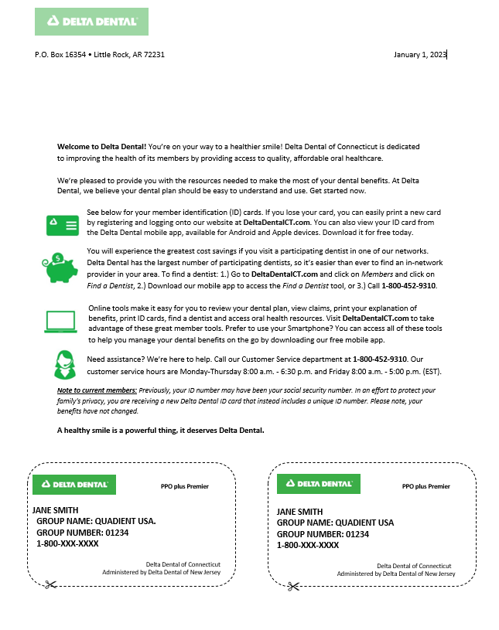

Dental ID Cards
  Everyone enrolled will receive ID Cards for dental plan
  Unique Member ID Number
  2 subscriber only ID cards issued
  Additional ID cards are available through our member portal, MySmiles
PPO plus Premier
PPO plus Premier
JANE SMITH Member ID: 1234567890 GROUP NAME: WEBSTER BANK, N.A. GROUP NUMBER: 04759 1-800-XXX-XXXX
Delta Dental of Connecticut
Administered by Delta Dental of New Jersey
Delta Dental of Connecticut
Administered by Delta Dental of New Jersey
For your PPO Plus Premier Plan
Your ID cards are available online in the MySmile Portal at: https://www.deltadentalct.com/websterbank

Slide 11
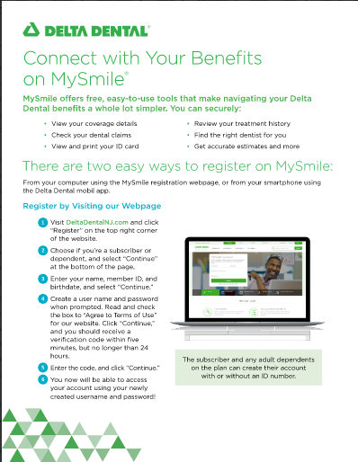

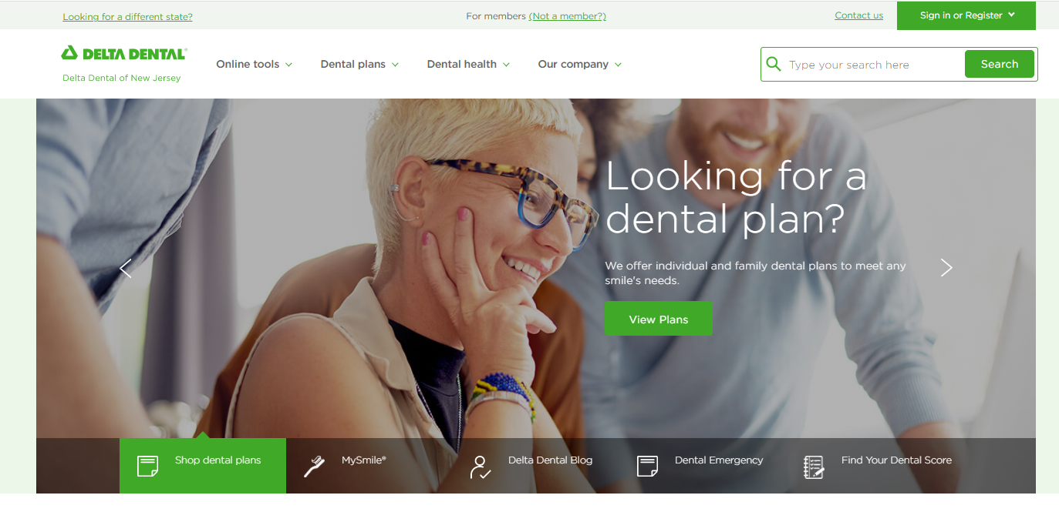
Delta Dental Website
Register and log into your My Smile® account at www.deltadentalct.com/websterbank to access your dental benefits
Use the same log in information to access your dental benefits information in the Delta Dental App
Need a dentist? Click our ‘Find a Dentist’ to search for a dentist near you
Watch this!
Navigating the website
  New Page
  Member dashboard
  Find and recommend a dentist
Your EOB Explained
Why it pays to stay in network
Step-by-Step
Member Registration

Slide 12

Your Resources – Connect with Delta Dental
Delta Dental PPO Plus Premier Plan
(Group #04759)
Customer Service 1-800-358-4371
  Call or go online for these services:
      Review benefits
      Look up claim payments
      Find a dentist
      Cost Estimator – on mobile app
      Print or download ID card
  Website: www.deltadentalct.com/websterbank

Slide 13
Questions?
Log into the MySmile® portal
or
Contact us at 1-800-358-4371

